Slide 1
Professional Diploma in Commercial Web Design
Lesson 1
MySQL
By Raymond Tsang in Fevaworks
t-raymond.tsang@fevaworks.com

Slide 2
What is a Database
A database is a structured collection of records or data.
A collection of organized information
A computer database relies upon software to organize the storage of data.
Database management systems (DBMS) are the software used to organize and maintain the database.
SQL is the language that access the database.

Slide 3
Why we need a Database
We need to share LARGE AMOUNT OF DATA between users, between tools working on them, and usually between different computers.
Several users and/or several tools must be able to SAFELY ACCESS the same data CONCURRENTLY.
We need persistent storage will last for a long period. This storage must also be RELIABLE.
We need to access to large amounts of data QUICKLY, through indexing and other optimizations.
A DBMS and its data model provides an abstraction; we do not need to care about the physical storage format.

Slide 4
How to connect to a Database
PHP has a connector to all different databases. All you need is to call a function to connect to the database
In Dreamweaver, you can use the UI instead of typing.

Slide 5
Compare Databases
Microsoft SQL Server
Microsoft SQL Server Express 2016 – 10G, free, good performance, but no UI
Microsoft Office Access – 2G, with easy to use UI and templates
Sun Micro MySQL – 4T, free to use, cannot bundle with products
Postgre – free, absolutely free
DB2 – 4G – 9.7
Oracle – 12g R2
EnterpriseDB

Slide 6
Database requirements
Data is the most important thing.
Performance, concurrency, integrity, size limit and recovery from hardware failures are need to considered.
Scale Up - upgrade hardware (RAM, HD) or Scale Out (buy extra server as a grid)?

Slide 7
Data and information
Data is useless
Information is useful
33, 28, 31, 25 is Data
33`C, 28`C, 31`C, 25`C is Information
Database only store Data
We, programmer, use PHP to display data to become the information

Slide 8
Who uses MySQL
Gov’t: NASA, United States Census Bureau,
Web: Yahoo!, flickr, Google, YouTube, facebook, Wikipedia, FOTOLOG, SKYROCK, Craigslist, Digg, Sourceforge, CitySearch,
Travel: SabreHoldings, active hotels, pivex, travelocity, Lufthansa, Continential Airlines, Priceline.com, booking.com
Retail: neckermann.de, GAP, B&Q, axfood, SUZUKI, macy's, spirit group, DaimlerChrysler, caterpillar, texas instruments
Telco: 8x8,Inc., vodafone, Systems, NOKIA, FIVE9, COX communications, Nevis Network, ALCATEL, STANDARD NETWORKS, Earthlink, Ericsson
OEM/ISV: enterasys, JASPERSOFT, QUEST SOFTWARE, symantec, netiQ, CISCO SYSTEMS, sas, Proofpoint
Others: UPS, The associated Press, Hoover’s Online, omaha steaks, HypoVereinsbank

Slide 9
MySQL Price
Oracle now charges $2,000 per server for MySQL Standard Edition support, which doubles to $4,000 for servers with five or more sockets; and $5,000 per server for Enterprise Edition, which also doubles to $10,000 for five-plus sockets.
Oracle has also introduced a Cluster Carrier Grade edition that is priced at $10,000 per server for one- to four-socket servers and $20,000 per server for those with five or more.

Slide 10
MySQL File Size
Operating System | File-size Limit
Win32 w/ FAT/FAT32 | 2GB/4GB
Win32 w/ NTFS | 2TB (possibly larger)
Linux 2.2-Intel 32-bit | 2GB (LFS: 4GB)
Linux 2.4+ | (using ext3 file system) 4TB
Solaris 9/10 | 16TB
MacOS X w/ HFS+ | 2TB
NetWare w/NSS file system | 8TB
http://dev.mysql.com/doc/refman/4.1/en/full-table.html

Slide 11
Pos of using MySQL
Open source - free to use
Comes with Linux – up to 4G database
Implementation costs only 10-20% of the price of commercial databases (Oracle, IBM, MS)
Capable of handling routine and even critical computing tasks, easy to manage
Usually used for new, custom-built apps
More third-party products now support the open-source database

Slide 12
Cons of using MySQL
Companies have invested in apps that run on commercial databases
MySQL is not highly scalable and lacks triggers, views and stored procedures
Few packaged apps run on MySQL
Big-name software vendors such as peoplesoft, SAP, and Siebel Systems do not support it

Slide 13
Performance
MySQL Database 5.5 delivers enterprise features, including:
Improved! Up to 1500% faster performance on Windows
Improved! Up to 370% faster performance on Linux
Improved! Better scalabilty on modern, multi-core, multi-CPU hardware
New! Performance Schema for monitoring MySQL server run-time performance
New! Semi-synchronous replication to ensure data consistency and redundancy
New! Replication Heartbeat to immediately uncover replication interruptions
New! Partitioning options for faster lookups
New! Easier development and debugging of stored procedures, functions, and triggers

Slide 14
Performance
Reliability requiring little or no intervention to achieve continuous uptime
Ease of use with "15 minutes to success" installation and configuration
Low administration with very little database maintenance required
Replication providing flexible topologies for scale-out and high availability
Partitioning to improve performance and management of very large database environments
ACID Transactions to build reliable and secure business critical applications
Stored Procedures to improve developer productivity
Triggers to enforce complex business rules at the database level
Views to ensure sensitive information is not compromised
Information Schema to provide easy access to metadata
Pluggable Storage Engine Architecture for maximum flexibility

Slide 15
Site
http://www.mysql.com (Eng)
http://dev.mysql.com/doc/ (Manual)

Slide 16
How large can MySQL handle
60000 tables
5 billion rows
8 million terabytes in some system

Slide 17
Top Reasons to Use MySQL
1. Scalability and Flexibility
The MySQL database server provides the ultimate in scalability, sporting the capacity to handle deeply embedded applications with a footprint of only 1MB to running massive data warehouses holding terabytes of information. Platform flexibility is a stalwart feature of MySQL with all flavors of Linux, UNIX, and Windows being supported. And, of course, the open source nature of MySQL allows complete customization for those wanting to add unique requirements to the database server.
2. High Performance
A unique storage-engine architecture allows database professionals to configure the MySQL database server specifically for particular applications, with the end result being amazing performance results. Whether the intended application is a high-speed transactional processing system or a high-volume web site that services a billion queries a day, MySQL can meet the most demanding performance expectations of any system. With high-speed load utilities, distinctive memory caches, full text indexes, and other performance-enhancing mechanisms, MySQL offers all the right ammunition for today's critical business systems.

Slide 18
Top Reasons to Use MySQL
3. High Availability
Rock-solid reliability and constant availability are hallmarks of MySQL, with customers relying on MySQL to guarantee around-the-clock uptime. MySQL offers a variety of high-availability options from high-speed master/slave replication configurations, to specialized Cluster servers offering instant failover, to third party vendors offering unique high-availability solutions for the MySQL database server.
4. Robust Transactional Support
MySQL offers one of the most powerful transactional database engines on the market. Features include complete ACID (atomic, consistent, isolated, durable) transaction support, unlimited row-level locking, distributed transaction capability, and multi-version transaction support where readers never block writers and vice-versa. Full data integrity is also assured through server-enforced referential integrity, specialized transaction isolation levels, and instant deadlock detection.

Slide 19
Top Reasons to Use MySQL
5. Web and Data Warehouse Strengths
MySQL is the de-facto standard for high-traffic web sites because of its high-performance query engine, tremendously fast data insert capability, and strong support for specialized web functions like fast full text searches. These same strengths also apply to data warehousing environments where MySQL scales up into the terabyte range for either single servers or scale-out architectures. Other features like main memory tables, B-tree and hash indexes, and compressed archive tables that reduce storage requirements by up to eighty-percent make MySQL a strong standout for both web and business intelligence applications.
6. Strong Data Protection
Because guarding the data assets of corporations is the number one job of database professionals, MySQL offers exceptional security features that ensure absolute data protection. In terms of database authentication, MySQL provides powerful mechanisms for ensuring only authorized users have entry to the database server, with the ability to block users down to the client machine level being possible. SSH and SSL support are also provided to ensure safe and secure connections. A granular object privilege framework is present so that users only see the data they should, and powerful data encryption and decryption functions ensure that sensitive data is protected from unauthorized viewing. Finally, backup and recovery utilities provided through MySQL and third party software vendors allow for complete logical and physical backup as well as full and point-in-time recovery.

Slide 20
Top Reasons to Use MySQL
7. Comprehensive Application Development
One of the reasons MySQL is the world's most popular open source database is that it provides comprehensive support for every application development need. Within the database, support can be found for stored procedures, triggers, functions, views, cursors, ANSI-standard SQL, and more. For embedded applications, plug-in libraries are available to embed MySQL database support into nearly any application. MySQL also provides connectors and drivers (ODBC, JDBC, etc.) that allow all forms of applications to make use of MySQL as a preferred data management server. It doesn't matter if it's PHP, Perl, Java, Visual Basic, or .NET, MySQL offers application developers everything they need to be successful in building database-driven information systems.
8. Management Ease
MySQL offers exceptional quick-start capability with the average time from software download to installation completion being less than fifteen minutes. This rule holds true whether the platform is Microsoft Windows, Linux, Macintosh, or UNIX. Once installed, self-management features like automatic space expansion, auto-restart, and dynamic configuration changes take much of the burden off already overworked database administrators. MySQL also provides a complete suite of graphical management and migration tools that allow a DBA to manage, troubleshoot, and control the operation of many MySQL servers from a single workstation. Many third party software vendor tools are also available for MySQL that handle tasks ranging from data design and ETL, to complete database administration, job management, and performance monitoring.

Slide 21
Top Reasons to Use MySQL
9. Open Source Freedom and 24 x 7 Support
Many corporations are hesitant to fully commit to open source software because they believe they can't get the type of support or professional service safety nets they currently rely on with proprietary software to ensure the overall success of their key applications. The questions of indemnification come up often as well. These worries can be put to rest with MySQL as complete around-the-clock support as well as indemnification is available through MySQL Network. MySQL is not a typical open source project as all the software is owned and supported by MySQL AB, and because of this, a unique cost and support model are available that provides a unique combination of open source freedom and trusted software with support.
10. Lowest Total Cost of Ownership
By migrating current database-drive applications to MySQL, or using MySQL for new development projects, corporations are realizing cost savings that many times stretch into seven figures. Accomplished through the use of the MySQL database server and scale-out architectures that utilize low-cost commodity hardware, corporations are finding that they can achieve amazing levels of scalability and performance, all at a cost that is far less than those offered by proprietary and scale-up software vendors. In addition, the reliability and easy maintainability of MySQL means that database administrators don't waste time troubleshooting performance or downtime issues, but instead can concentrate on making a positive impact on higher level tasks that involve the business side of data.

Slide 22
Create a Database
We seldom have a chance to use command prompt to control our database. Moreover, it’s too dangerous for an end user to have too much rights/control.
We use phpMyAdmin to control a database.
http://localhost/phpmyadmin
http://localhost:8080/phpmyadmin

Slide 23
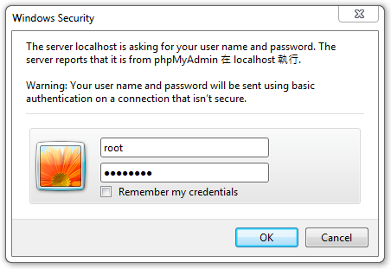
Login
http://localhost/phpmyadmin/
Username: root
Password: password

Slide 24
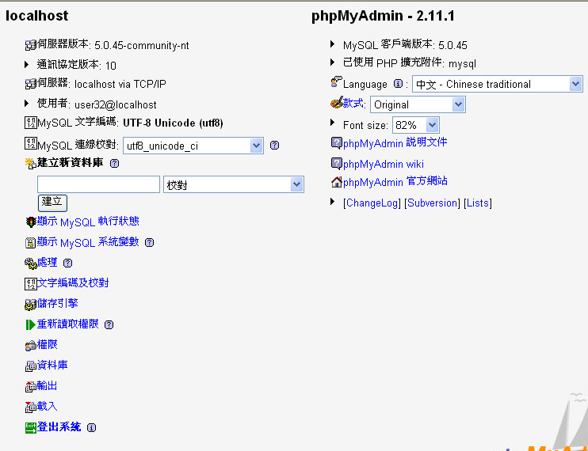

Slide 25
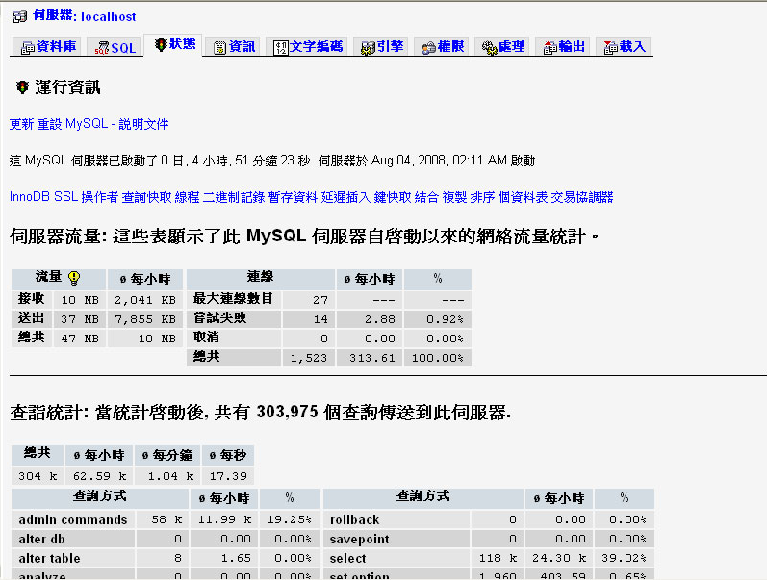

Slide 26
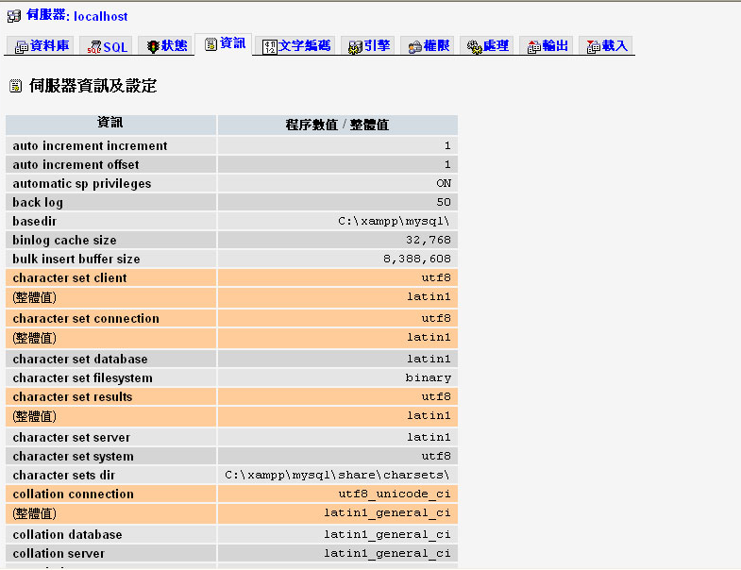

Slide 27
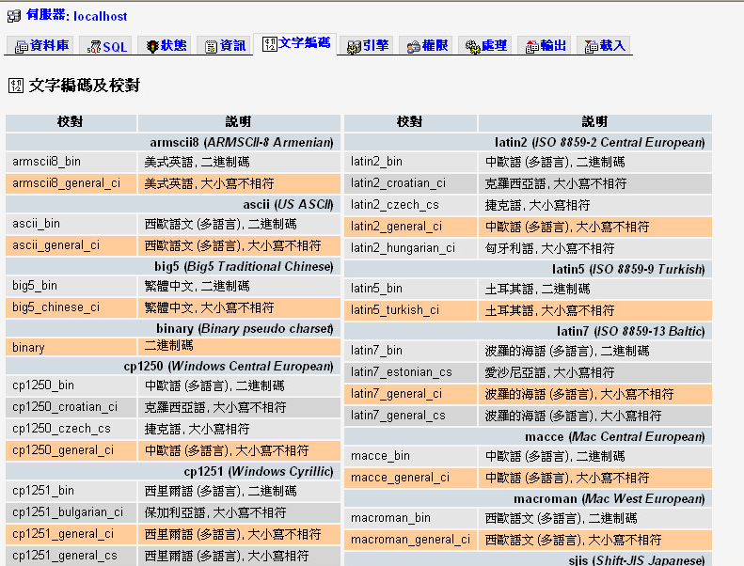

Slide 28
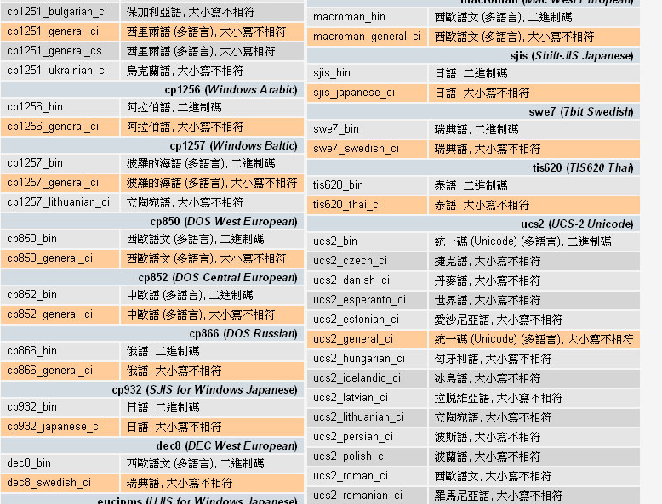

Slide 29
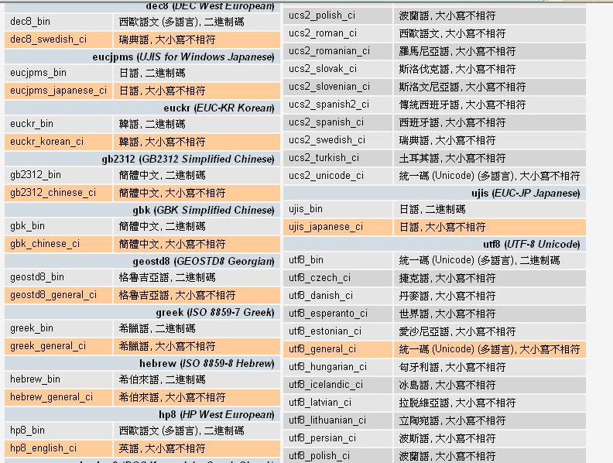

Slide 30
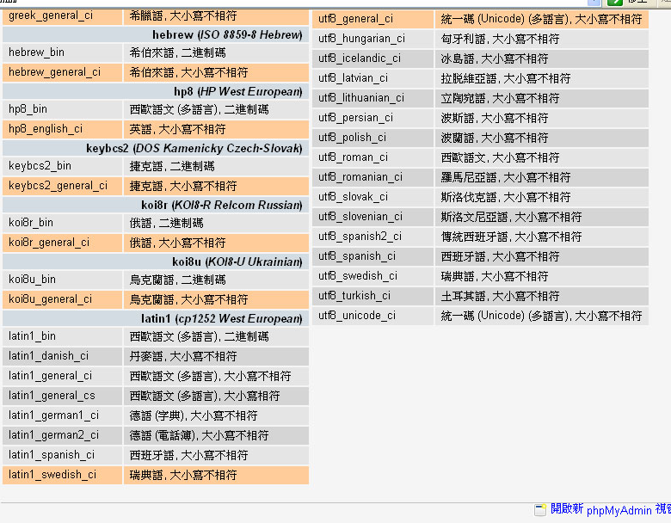

Slide 31
Character set
A character set is a set of symbols and encodings.
Unicode is the most common way for character set.
UTF-8 -> utf8_general_ci

Slide 32
Uni-code
MySQL 5.0 supports two character sets for storing Unicode data:
ucs2, the UCS-2 encoding of the Unicode character set using 16 bits per character
utf8, a UTF-8 encoding of the Unicode character set using one to three bytes per character
They usually include a language name, and they end with _ci (case insensitive), _cs (case sensitive), or _bin (binary).

Slide 33
Collation
A character set is a set of symbols and encodings. A collation is a set of rules for comparing characters in a character set..
Suppose that we have an alphabet with four letters: “A”, “B”, “a”, “b”. We give each letter a number: “A” = 0, “B” = 1, “a” = 2, “b” = 3. The letter “A” is a symbol, the number 0 is the encoding for “A”, and the combination of all four letters and their encodings is a character set.
Suppose that we want to compare two string values, “A” and “B”. The simplest way to do this is to look at the encodings: 0 for “A” and 1 for “B”. Because 0 is less than 1, we say “A” is less than “B”.

Slide 34
Database and Excel
Database = Excel files
Tables = Sheet
Record = Row
Field = Column
Value = Cell

Slide 35
Schemas
complete set of table design
test (id, message)
Shows each data types of a column and indicate the primary key(underline)
Primary key is the unique key in the table
Eg. HKID is primary key, so there are many people can use your name but no one else can have the same HKID as you.

Slide 36
Steps to create database
Create database
Create table
Create fields

Slide 37
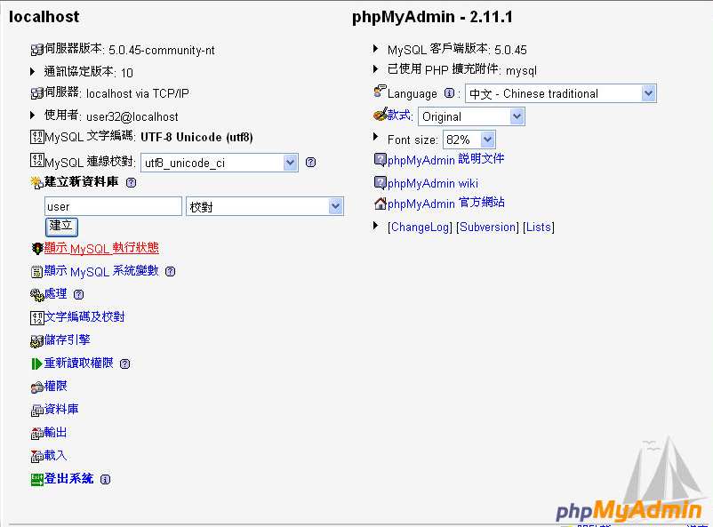

Slide 38
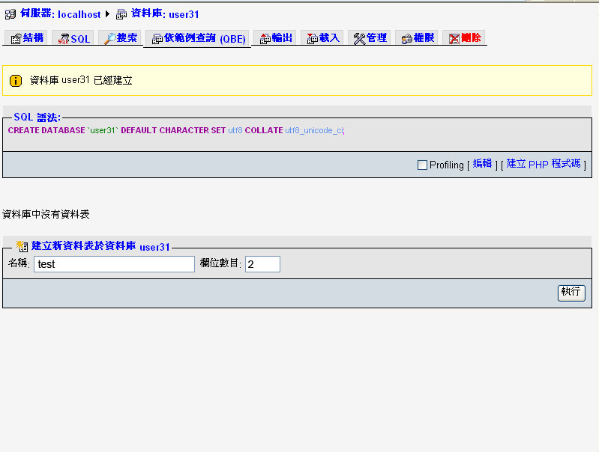

Slide 39
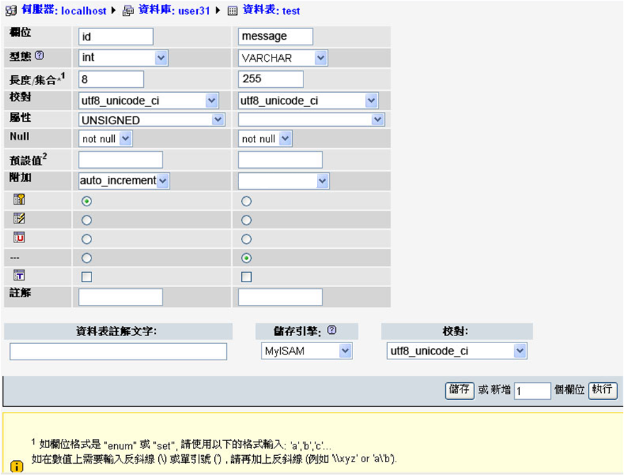

Slide 40
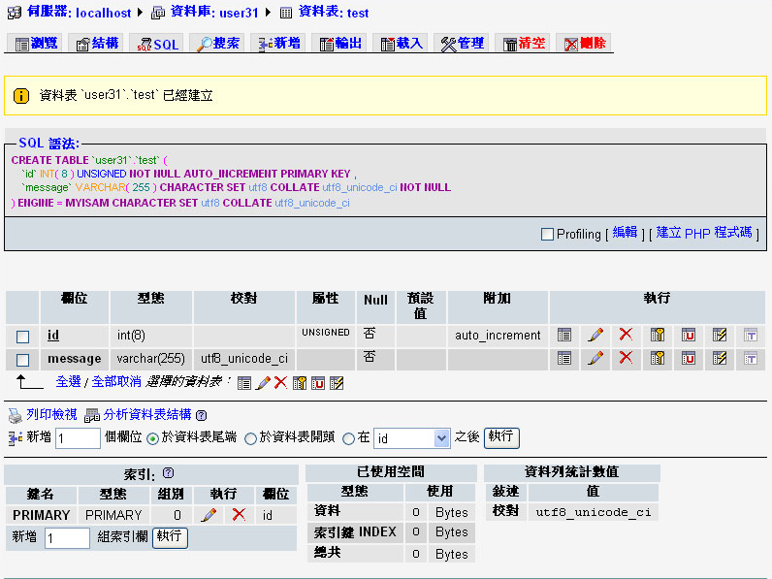

Slide 41
int
Type | Storage | Minimum Value | Maximum Value
 | (Bytes) | (Signed/Unsigned) | (Signed/Unsigned)
TINYINT | 1 | -128 | 127
 |  | 0 | 255
SMALLINT | 2 | -32768 | 32767
 |  | 0 | 65535
MEDIUMINT | 3 | -8388608 | 8388607
 |  | 0 | 16777215
INT | 4 | -2147483648 | 2147483647
 |  | 0 | 4294967295
BIGINT | 8 | -9223372036854775808 | 9223372036854775807
 |  | 0 | 18446744073709551615

Slide 42
Decimal number
Fixed-Point Types (Exact Value) - DECIMAL, NUMERIC
Floating-Point Types (Approximate Value) - FLOAT, DOUBLE 0.001=0

Slide 43
Create table
var：不定長度→ n+1
char宣告的是固定的長度，因此如果宣告char(5)，但是只放a這個字，那麼就會補另外4個空白，會補空白補滿是他的特性
varchar是不定長度，因此如果宣告varchar(5)，但是只放a這個字，那麼就會放一個a，不會補空白。

Slide 44
CREATE TABLE `test` (
`id` int(10) unsigned NOT NULL auto_increment,
`message` varchar(140) default NULL,
PRIMARY KEY (`id`)
) ENGINE=MyISAM DEFAULT CHARSET=utf8

Slide 45
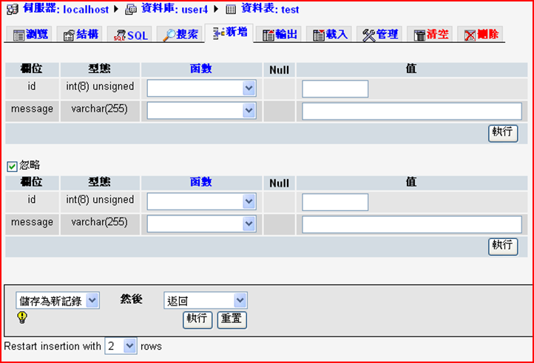
INSERT

Slide 46
INSERT
Field | Type | Function | Null | Value
id | int(8) unsigned
message | varchar(255) |  |  | Hi
id | int(8) unsigned
message | varchar(255) |  |  | How are you?
id | int(8) unsigned
message | varchar(255) |  |  | I am fine
id | int(8) unsigned
message | varchar(255) |  |  | Great!
Add 10 more records

Slide 47
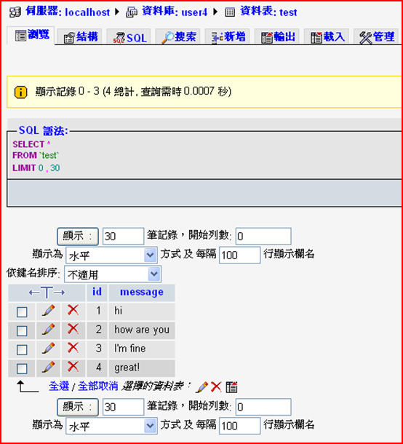
Browse / Query

Slide 48
Update
Click the pencil icon to update the record

Slide 49
Delete
Click the cross icon to delete the record

Slide 50
Homework
Create a table for member registration

Slide 51
QUESTIONS

